Slide 1
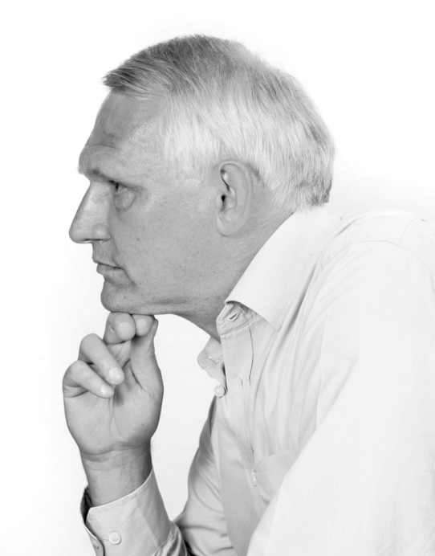
James A Robertson and Associates
Effective Strategic Business Solutions
Webinar on Webinars
For the
Professional Speakers Association of Southern Africa
Dr James Robertson PrEng -- The ERP Doctor
Copyright 2013 James@JamesARobertson.com
Notes:
NB remember to have a chair to stand on
Make sure to take the CRITICAL FACTORS BOOK with you
An engineer with a PhD in engineering

Slide 2
Housekeeping
Your microphones will be muted during the presentation
If there is a really urgent “point of clarification” question please “raise your hand” and use the chat facility
Microphones will be made live as required in order to take questions at the end of the session – please put your “hand” (on the console) up
We will email you links to a copy of the handouts and a copy of the recording in Drop Box after the presentation
A recording of the session – slides with sound – will be uploaded to Drop Box – we will send you links
You are welcome to send further questions by email to
James@JamesARobertson.com

Slide 3
Agenda
How to run effective Webinars
The base technology – GoToTraining from Citrix
Hardware and environment
Marketing
Content – the presentation
Checklist before starting
Delivery
Wrapping up
Housekeeping after the event

Slide 4
Agenda
How to run effective Webinars
The base technology – GoToTraining from Citrix

Slide 5
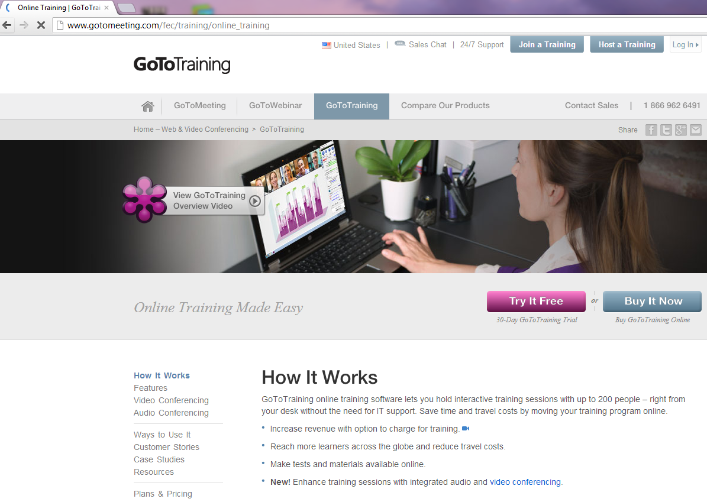

Slide 6
The base technology – GoToMeeting by Citrix
Are other products -- this is one of the best
Purchase options
25 delegate license US$149 per month – BEWARE of the “corporate offer” -- includes hosting of recordings of presentations so that you can make them available on your website
Paid version includes ability to charge for attendance – needs PayPal and a First National Bank account
There is an initial free trial of 30 days

Slide 7
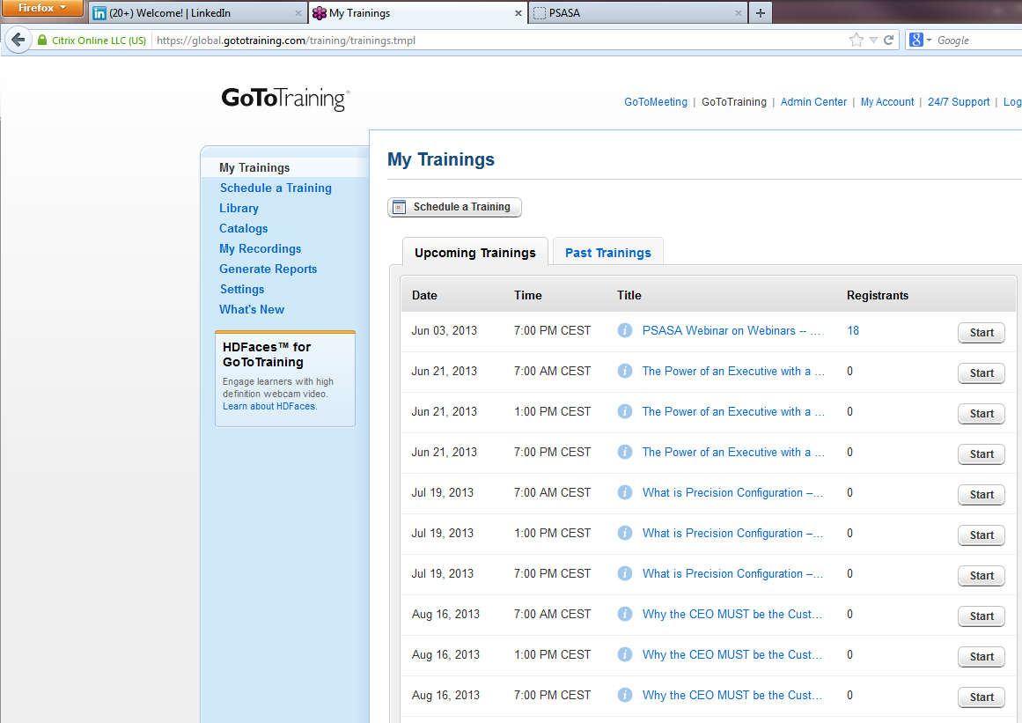

Slide 8
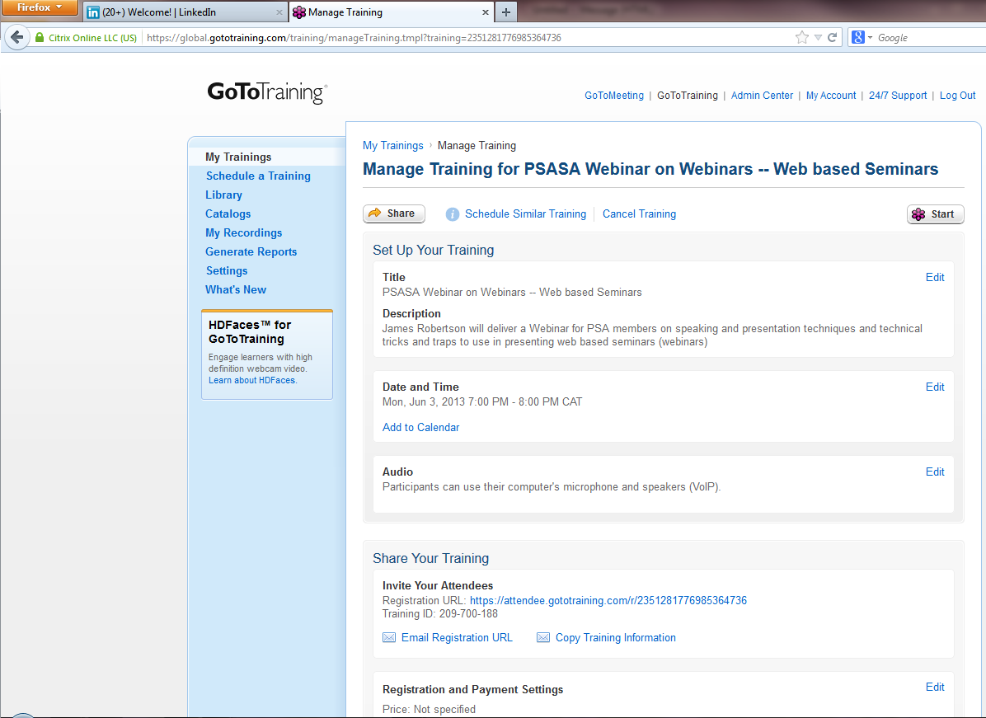

Slide 9
Agenda
How to run effective Webinars
The base technology – GoToTraining from Citrix
Hardware and environment

Slide 10
The hardware and the environment
May get by with standard microphone and speakers -- preferably at least a good quality USB headset – I use a professional microphone and head phones and a USB mixer
Minimize background noise and echo
Ensure no interruptions
Two screens recommended – control panel on second screen – drag other items off second screen

Slide 11
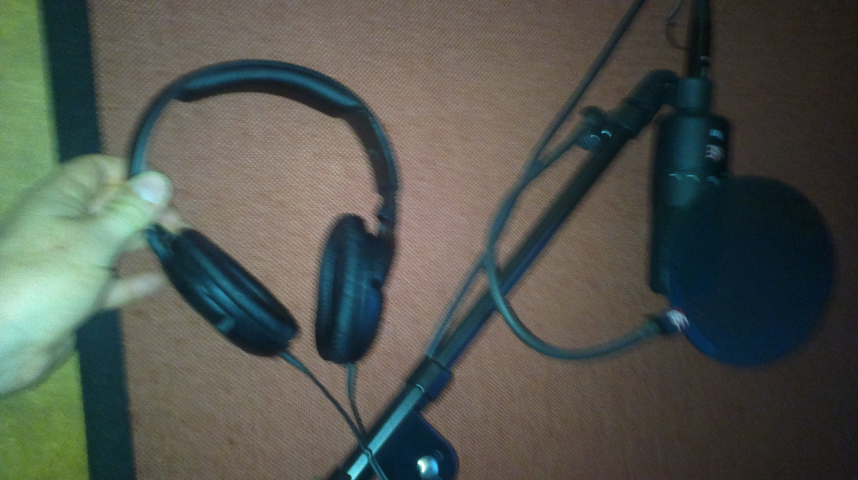
The hardware and the environment

Slide 12
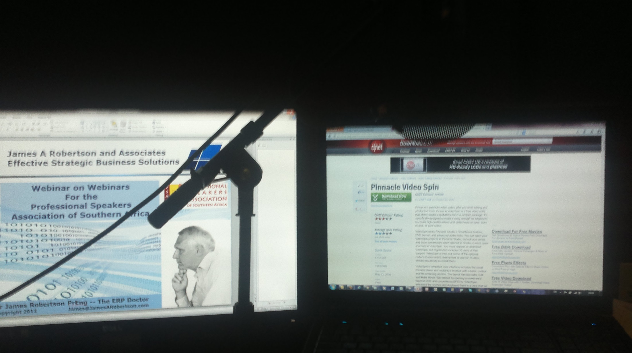
The hardware and the environment

Slide 13
Agenda
How to run effective Webinars
The base technology – GoToTraining from Citrix
Hardware and environment
Marketing

Slide 14
Marketing
Email marketing to your mailing list / newsletter
Email marketing to your LinkedIn Contacts -- download
Rent a mailing list – e.g. Analogue Marketing -- tony@interactivedirect.co.za
Direct invite works best, few people click on links in a newsletter
Backup with a newsletter
Pricing – range from free to whatever you think will fly – US$50 seems to work
Can have different discount codes, variable pricing
“On-line Presentation” or “On-line seminar” seems to work better than “Webinar” depending on your audience
Time of day – early morning or late afternoon work best – can do multiple times for different time zones

Slide 15
Agenda
How to run effective Webinars
The base technology – GoToTraining from Citrix
Hardware and environment
Marketing
Content – the presentation

Slide 16
Content – the Presentation
Photo on opening slide
This is NOT a video conference – COULD use GoToMeeting for a more interactive effect?
Preferably use screen shots rather than live demonstration of software, etc
Remember they cannot see you – voice, silence, pace are vital
I find fast paced is best – keep them following you – I have gone as high as 85 slides in an hour – with fast moving screen shots, etc
Use animation to pace yourself and add life – quick reveal of bullets – I think that word slides are hard to avoid if you are giving a technical presentation
Watch the bottom edge of the slide – gets lost – tune line spacing

Slide 17
Agenda
How to run effective Webinars
The base technology – GoToTraining from Citrix
Hardware and environment
Marketing
Content – the presentation
Checklists before starting

Slide 18
Checklists
Easy to get flustered when about to start – checklists help
Marketing checklist
Set-up checklist
Delivery checklist
First time do a couple of dry runs with a friend
Listen to the recordings

Slide 19
Marketing checklist
First notice about one month before
Newsletter about two weeks before
Notice of Webinar on selected LinkedIn Groups about two weeks before
Including own groups and Tweet
Webinar email to StratNews subscribers – about TEN days before
Notice of Webinar on LinkedIn updates every morning and evening for about one week before
Email people I have been talking to personally to remind them – about one week before
Other?

Slide 20
Set-up checklist
15 minutes BEFORE session
Print this out
Reboot computer and modem
Comfort break
Glass of water
3G card on standby
Shut down all unnecessary applications
Open spreadsheets and presentation
Fan off, printer off, dining room door closed, music down
Cell phone on silent
Make sure that CI2 is plugged in and lights are on; phantom Red
Position microphone
Login to GoToTraining AT LEAST TEN MINUTES AHEAD
Download list of delegates
Save version WITHOUT these notes
Close ALL other windows
Check microphone and earphones are working
Watch off where can see
Deep breaths

Slide 21
Delivery checklist – DURING session -- print this out
Watch off and visible
Display screen without Task Bar
Control Panel on right hand screen
Attendee list open
Cursor hovering over RECORD
RECORD ON
Watch for hands up
Watch for chat
STOP RECORDING
Process recording and upload – take dashes out of file name
Upload list into Group Mail
Email slides and book and link

Slide 22
Agenda
How to run effective Webinars
The base technology – GoToTraining from Citrix
Hardware and environment
Marketing
Content – the presentation
Checklists before starting
Delivery

Slide 23
Delivery
Remember to start recording – I start early – too easy to forget if leave to last minute
Speak clearly into the microphone
Do NOT panic if you lose connectivity – keep talking, the software generally DOES reconnect, worst case exit GoToTraining and reconnect, even worse – reboot KEEP CALM
I mute delegates else get feedback and distracting noise
Watch for questions on control panel – I tend NOT to take questions – challenge is what do the other delegates do – there is too much to cause them to drift away and very hard to get them back
Fast pace, use silence, change pitch and tone of voice – this is a VOICE presentation
Do NOT panic if you lose delegates

Slide 24
Delivery -- examples

Slide 25
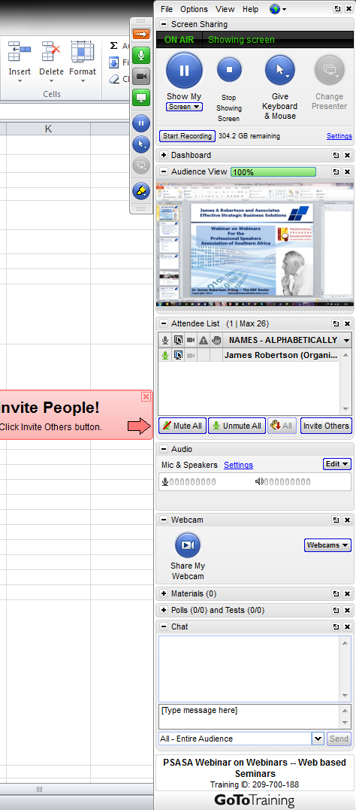
Control panel

Slide 26
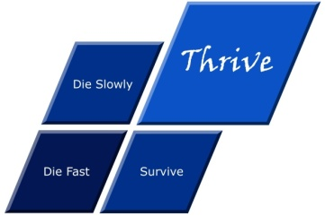
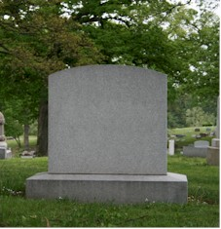
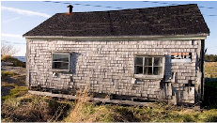
What is strategy?
Die fast
Thrive
Tactics – Doing things right ➔
Die
Die slowly
Survive
Strategy – Doing the right things ➔
Professor Malcolm McDonald – http://www.malcolm-mcdonald.com/

Slide 27
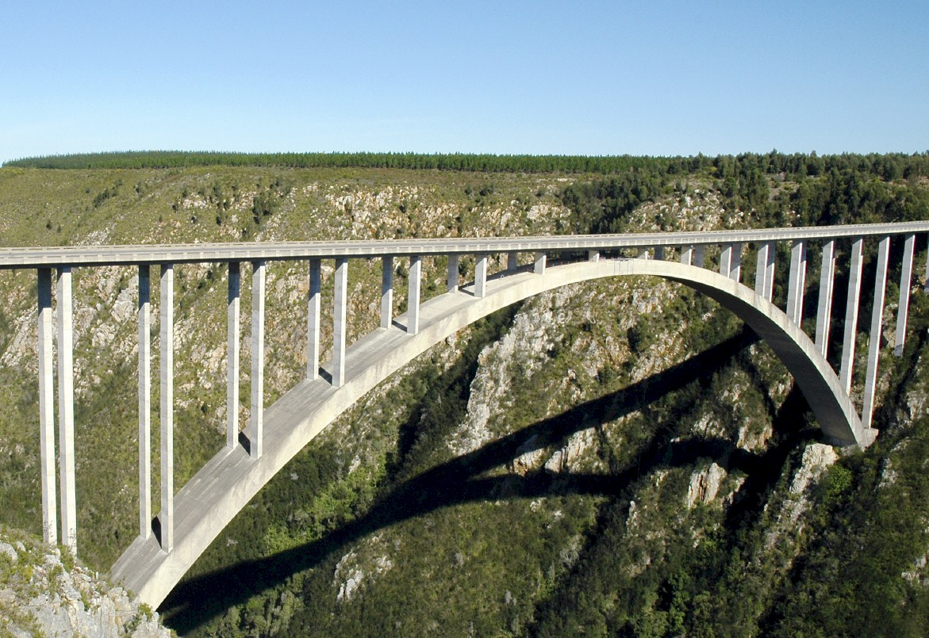
An ENGINEERING approach to strategy
Notes:
There is a fundamental difference in approach when one designs a bridge NOT TO FALL DOWN
Contrast this with the IT paradigm which could be called “designed to fail”

Slide 28
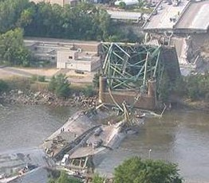
Engineers do NOT design bridges to stand up
Notes:
DHL, Prochem,

Slide 29
They design bridges NOT to fall down
Notes:
There is a fundamental difference in approach when one designs a bridge NOT TO FALL DOWN
Contrast this with the IT paradigm which could be called “designed to fail”

Slide 30
What is NOT an engineering approach?
Notes:
What is not an engineering approach? – Dramatically walk to chair – did this ever happen to you? –
WHEN SLEEPING
when i was a child i used to dream that i would stand on a chair and flap my arms and fly around the room --i have to say that that is NOT an engineering approach – as much as i may be convinced i can fly i have to say to you that were i to stand on top of a skyscraper and flap my arms and jump i would hit the ground at great speed and almost certainly die – that is NOT an engineering approach and yet many seem to think they can use software to do things magically – many are hypnotized and mesmerized by IT – are you? CLICK for rabbit out of the hat

Slide 31
Agenda
How to run effective Webinars
The base technology – GoToTraining from Citrix
Hardware and environment
Marketing
Content – the presentation
Checklist before starting
Delivery
Wrapping up

Slide 32
Wrapping up
Leave time for questions
I Unmute microphones if there is not too much background noise
May get into quite detailed discussion – remember there are OTHER delegates
Can ask that delegate to wait until have taken questions from the other delegates
Go round each delegate and ask for last questions or feedback before signing off
Can leave recording on but may need to edit before uploading
Clear close then end the session

Slide 33
Agenda
How to run effective Webinars
The base technology – GoToTraining from Citrix
Hardware and environment
Marketing
Content – the presentation
Checklist before starting
Delivery
Wrapping up
Housekeeping after the event

Slide 34
Housekeeping
Compress the video – automatically after end of session or there is an option to run the compression software separately
May need to trim off start and end sections of video – Pinnacle Video Spin is free – else any other video editing software
Upload to GoToTraining website – can link from your webpage
To upload to YouTube need to cut into segments of not more than 15 minutes approximately
Can put in Drop Box for delegates to download if required
Add delegates to newsletter mailing list
Lessons learned

Slide 35
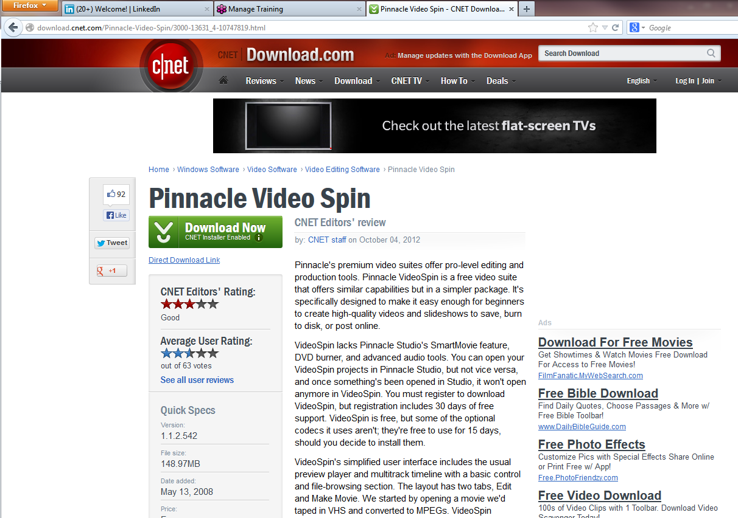

Slide 36
Summing Up
Fairly easy to do
Like all things the marketing is the challenge – NO marketing NO delegates
Distinct presentation style – exercise your voice
Need to hold your audience
A neat way of generating some base level revenue IF you have the content and delivery to warrant the fee
Can on-sell the recordings off your website

Slide 37
If you do not act within 48 hours you probably never will (Bill Gates)
Act TODAY! ☺
What is your single most important insight from this presentation?
What is the single most practical action that you can take tomorrow to apply strategic (right thing / essence thinking more effectively?
Please write down your thoughts
NOW
James@JamesARobertson.com

Slide 38
Questions?
We will email you a Drop Box link to the hand-outs and
recording of this presentation
"To Him who by wisdom made the heavens, for His mercy endures forever;"
Dr James Robertson PrEng – The ERP Doctor -- Mobile: +27-(0)83-251-6644
www.James-A-Robertson-and-Associates.com
James@JamesARobertson.com
LinkedIn: http://uk.LinkedIn.com/in/DrJamesARobertsonERPDoctor
Assisting clients to thrive through the effective application of IT and ERP – high value, high reliability solutions

